Slide 1


Asset Management
Answering the 5 Core Questions
by Timothy Taber, PE
Barton & Loguidice
Powerpoint Templates

Slide 2
Agenda
Asset Management Case Study
  What is the current state of my assets?
  What is my required “sustainable” level of service?
  Which assets are critical to sustained performance?
  What are my minimum life cycle costs?
  What is my best long-term funding strategy?

Slide 3
Question #1
What is the current state of my assets?
  What do I own?
  Where is it?
  What condition is it in?
  What is its remaining useful life?
  What is its remaining economic value?

Slide 4
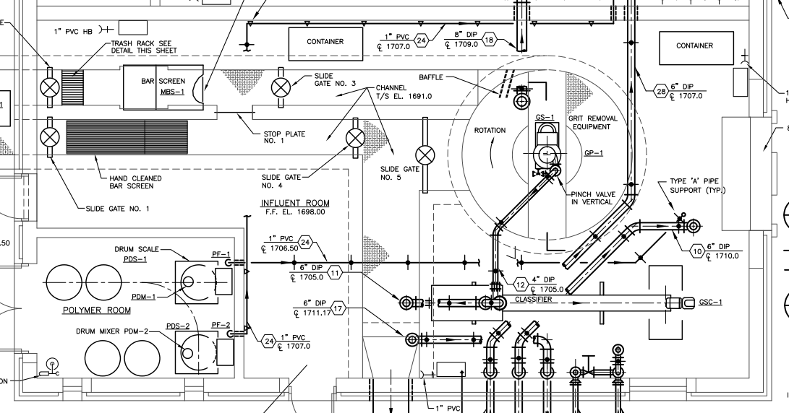
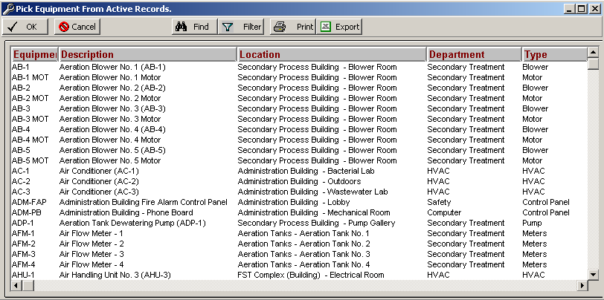
What is the current state of my assets?
What do I own? - Where is it?

Slide 5
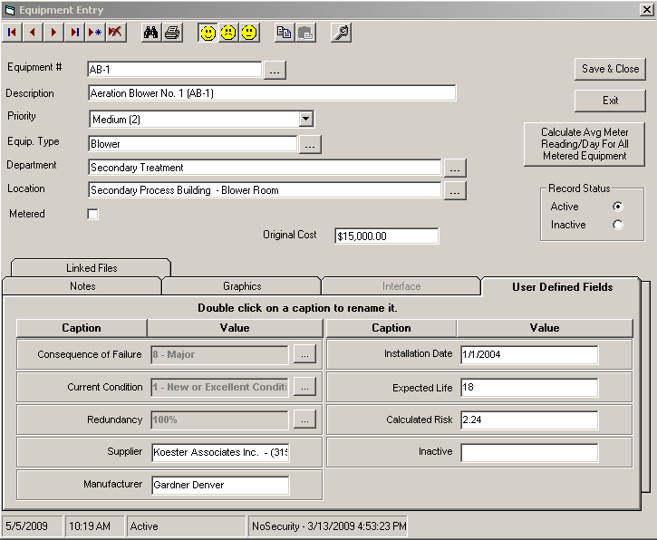
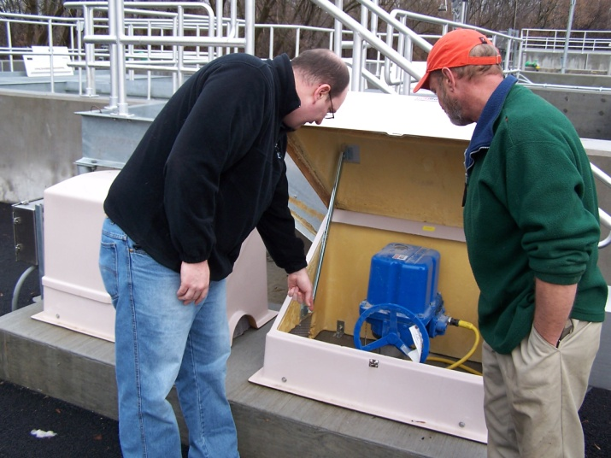
Information needed on my assets?
Information for Asset Management
Consequence of Failure
Current Condition
% Redundancy
Installation Date
Expected Life
Replacement Cost

Slide 6
Asset Expected Life Guidelines
Asset Type | Estimated Useful Life
Buildings | 37.5
Charger | 12.5
Computer Equipment / Software | 5
Concrete & Metal Storage Tanks | 45
Disinfection Equipment | 10
Distribution Pipes | 37.5
Door | 37.5
Galleries and Tunnels | 35
Hydrants | 45
Hydropneumatic Tanks | 10
Intake Structures | 40
Lab / Monitoring Equipment | 6
Land | 300
Meters | 12.5
Asset Type | Estimated Useful Life
Motor Controls / Drives | 10
Pressure Pipework | 60
Pumping Equipment | 10
Security Equipment | 7
Sensors | 8.5
Service Lines | 35
Sewers | 100
Tools and Shop Equipment | 12.5
Transformers / Switchgears / Wiring | 20
Transmission Mains | 37.5
Transportation Equipment | 10
Treatment Equipment | 12.5
Valves | 30
Wells and Springs | 30

Slide 7
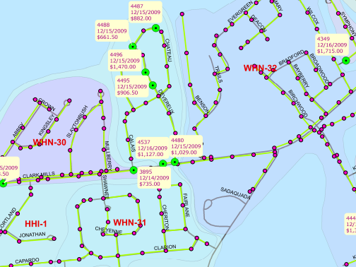
What is the current state of my assets?
What do I own? - Where is it?

Slide 8
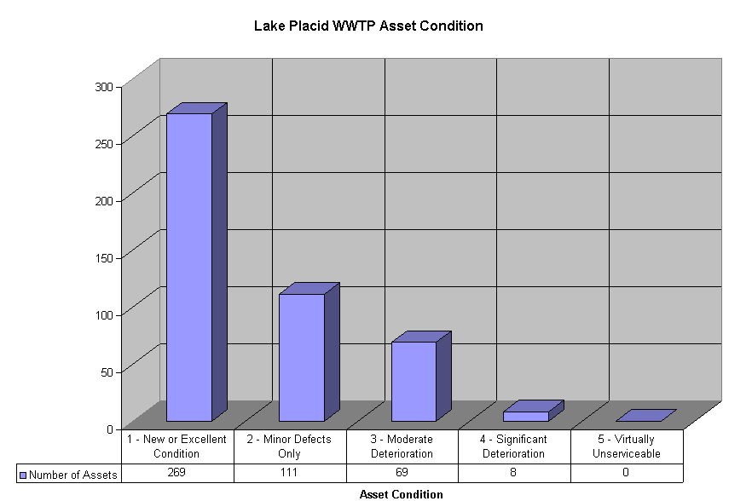
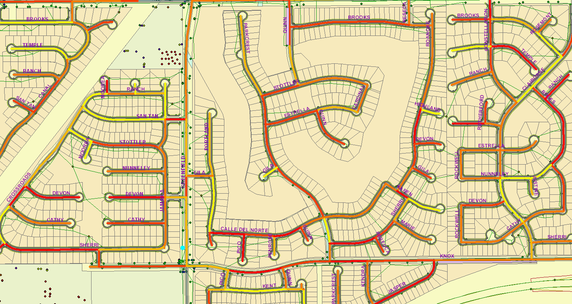
What is the current state of my assets?
What condition is it in?

Slide 9
Condition Assessment Protocols (CAP’s)
Which assets? What information? How used?
CAP 1 - A simple scoring system: “good, fair, poor” or 1-5 or 1-10
CAP 2 - A matrix scoring system with
multiple distress factors and weightings to derive a score
CAP 3 - Use of sophisticated techniques
        to determine the “residual life to intervention” or end of physical life

Slide 10
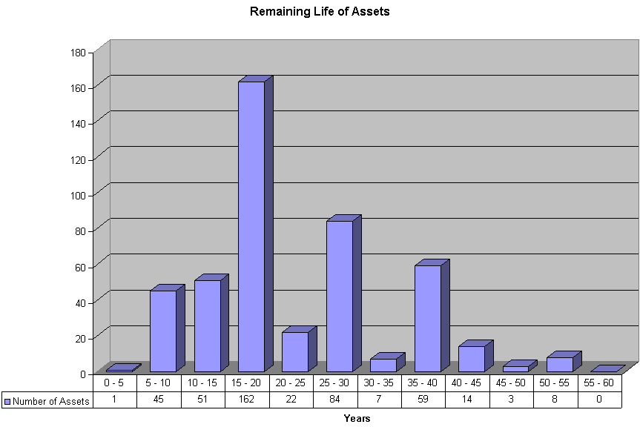
What is the current state of my assets?
What is its remaining useful life?

Slide 11
Question #2
What is my required level of service?
What is the demand for my services by my stakeholders?
What do regulators require?
What is my actual performance?

Slide 12
Why LOS?
It helps us…
Concentrate (focus) efforts & resources
  On agreed on service levels
  Less “service level defined by notion”
Communicate service expectations and choices
  Increased service = increased costs
  Discussion of trade-offs & risks
Negotiate (regulators and council/commission/board)
  Service levels
  Costs & budgets
  Rate impacts
  Reinvestments for Renewal
  Level of Risk
Notes:
Tom can use LOS to Concentrate (focus) his resources on clearly defined performance and reliability standards. He can mitigate some of the long-term impacts of continuous “do more for less” approach.

Slide 13
The Management Model
Customer
Expectations
Cost
of Service
Level
of Service
Business
Risk
Balance

Slide 14
What is my required level of service?
Level of Service | Target
Employee health and safety | Zero Injuries
Competitive rates / taxes | Within 5% of New York State average
Public image | No adverse media reports
Compliance with effluent discharge permits | 100%

Slide 15
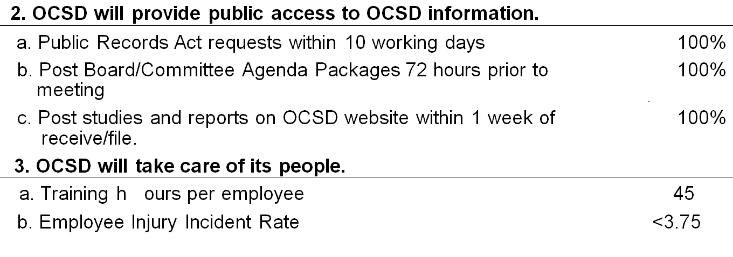
LOS statement
ENVIRONMENTAL
SOCIAL
2005 Target Level
Key Performance Indicators
2005 Target Level
Key Performance Indicators
of Service
1. OCSD will comply with effluent quality standards.
of Ser
vice
1. OCSD will be a good neighbor and will be responsive to its customers.
a. Compliance with all Ocean Discharge Permit Limits, %
100%
b.
a. Off site Biosolids nuisance complaints
0
b. Concentration of Emerging Chemical Constituents of Concern,
NDMA < 150 ppt
Odor complaint response
Plant No. 1 Secondary Effluent
1,4 Dioxane <2ppb
Treatment Plants within 1 hour
100%
c. Ef
fluent total coliform bacteria after initial dilution, mpn
<1,000
Collection System within 1 working day
100%
d. Source Control permitee compliance with permit conditions,
>90%
c. Restore collection service to customer within 8 hours
100%
percent
d. Respond to public complaints or inquiries regarding construction
>90%
2. OCSD will manage flows reliably.
projects within
1 working day
a. Frequency of use of emergency 1
e. Respond to collection system spills within 1 hour
100%
-
mile outfall
0 per year during dry
f. New connection permits processed within one working day
>90%
weath
er
g. Dig Alert response within 48 hours
100%
< once per 3 years
2. OCSD will provide public access to OCSD information.
b. Sanitary sewer spills per 100 miles
in peak wet weather
a. Public
Records Act requests within 10 working days
100%
c. Contain sanitary sewer spills within 5 hours
< 2.1
b. Post Board/Committee Agenda Packages 72 hours prior to
100%
3. OCSD’s effluent will be recycled.
100%
meeting
c. Post studies and reports on OCSD website within 1 week of
100%
a. Treated effluent reclaimed, % (flow)
4% (10 mgd)
receive/file.
4. OCSD will impleme
nt a sustainable biosolids management
3. OCSD will take care of its people.
program.
a. Training h
ours per employee
45
a. National Biosolids Program Certification for Environmental
Maintain
b. Employee Injury Incident Rate
<3.75
Management System
b. Percent of biosolids beneficial reuse
100%
ECONOMIC
Class "B"
40%
2005 Target Level
Class "A/EQ"
60%
Key Performance Indicators
of Service
5. OCSD will improve the regional wa
tershed.
1. OCSD will exercise sound financial management.
a. Dry weather urban runoff collected and treated
4 mgd
a. New borrowing
Not more than
b. Rainfall induced inflow and infiltration, wet weather peak factor
<2.2
annual Capital
c. Stormwater management, % of treatment process area runoff
100%
Improvement
treated on
Program
-
site
requirem
ents
d. Per capital wastewater flo
w rate, gallons per person per day
<105
b. COP coverage ratio
Between 1.25 and
6. OCSD will protect the air environment.
c. COP service Principal and Interest
2.0
a. Odor complaints: Reclamation Plant No. 1
< than O&M
Treatment Plant No. 2
5
d. Annual SFR user fee increase
expenses
Collection System
4
e. Annual user fees
not more than 15%
b. Air emissions health risk to:
Sufficient to cover all
Community, cancer risk per 1 million
<25
f. Annual increase in collection
, treatment, and disposal costs per
O&M requirements
Em
ployees
<25
million gallons
< 10%
c. Air mass emissions permit compliance, %
100%
g. Annual variance from adopted reserve policy
<5%
Notes:
Also
SDOT
HWD

Slide 16
Question #3
Which assets are critical to sustained performance?
How does it fail? How can it fail?
What is the likelihood of failure?
What does it cost to repair?
What are the consequences of failure?
RISK

Slide 17
Which assets are critical to sustained performance?
Consequence of Failure
Scoring Criteria
2 - Insignificant
4 - Minor
6 - Moderate
8 - Major
10 - Catastrophic
Spill, Flood, Odor
Water or Effluent Quality
Regulatory Compliance
Loss of Service to Customers
Equipment and Safety
Economic Impact

Slide 18
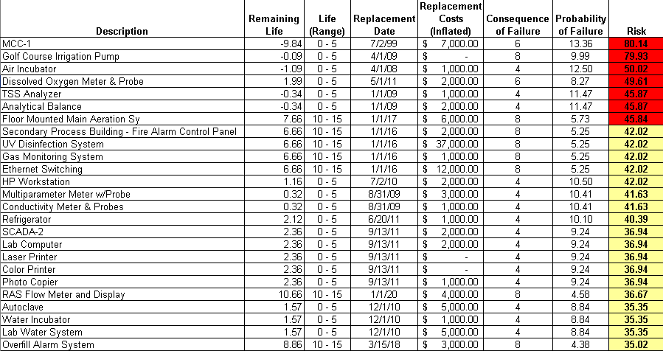
Which assets are critical to sustained performance?
Probability of Failure
Probability that the asset will fail
(no longer perform its function) in a given year.
Probability of Failure = ((Estimated Useful Life – Remaining Useful Life) / Estimated Useful Life) * (1 – Redundancy Factor) * 10

Slide 19
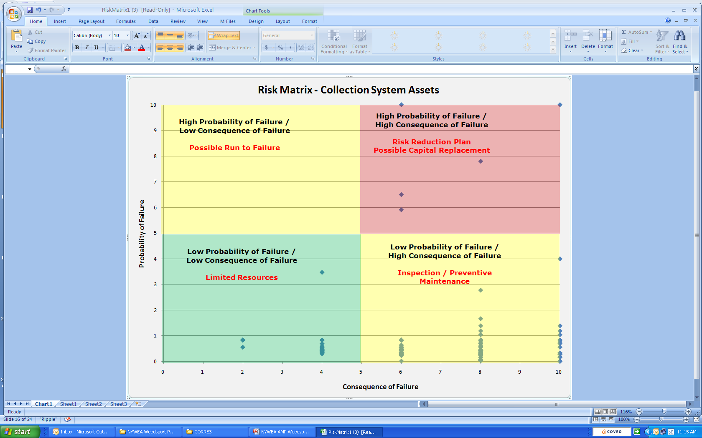
Which assets are critical to sustained performance?

Slide 20
Four Major Failure Modes
Failure Mode | Definition | Tactical Aspects | Management Strategy
Capacity | Volume of demand exceeds design capacity | Growth, system expansion | Redesign
Level of Service | Functional requirements exceed design capacity | Codes & permits: NPDES, CSOs, OSHA, noise, odor, life safety; service, etc. | O&M optimization, renewal
Mortality | Consumption of asset reduces performance below acceptable level | Physical deterioration due to age, usage (including operator error), acts of nature | O&M optimization, renewal
Financial Efficiency | Operations costs exceed that of feasible alternatives | Pay-back period | Replace
Notes:
Imminent Failure Mode – drives
If you don’t understand this, you can’t get the PoF correct
STEP THRU
We needed to review these failure modes

Slide 21
Which assets are critical to sustained performance?
Consequence by LOS Category
Consequence Category | Weight | Negligible = 1 | Low = 4 | Moderate = 7 | Severe = 10
Health &Safety | 0.20 | No injuries or adverse health effects | No lost-time injuries or medical attention | Lost-time injury or medical attention | Loss of life
Compliance with Regulation | 0.20 | 100% compliance with permits | Technical violation but no enforcement action | Violation with minor enforcement action | Enforcement action with fines
Financial Impact | 0.10 | Absorbed within budget line item | Absorbed within current budget | May require transfer from reserves | May require new borrowing or im pact rates
Disruption to the Community | 0.15 | No social or economic impact | Minor disruption (e.g., traffic, dust, noise) | Short-term impact; substantial disruption | Long-term impact; area-wide disruption
Service Delivery | 0.20 | No overflows, backups, or odors | No dry weather overflows or backups; infrequent odors | Short duration dry weather overflows or backups; occasional odor | Numerous overflows, backups; widespread or persistent odors
Ability to Respond and Continue Service | 0.15 | < 2 hours | 2 to < 8 hours | 8 to < 24 hours | > 24 hours

Slide 22
Sample Likelihood of Failure Matrix and Scoring System
Likelihood of Asset Failure by Category
Likelihood Category | Weight | Negligible = 1 | Unlikely = 2 | Possible = 4 | Likely = 7 | Very Likely = 10
Physical Condition | 0.60 | Very good (Condition Grade I) | Good (Condition Grade 2) | Fair (Condition Grade 3) | Poor (Condition Grade 4) | Very poor (Condition Grade 5)
Performance | 0.20 | Sufficient capacity to meet average and peak flow requirements; appropriate utilization and function | Under-utilized or oversized, causing O&M issues | Sufficient capacity but does not meet functional requirements or over-utilized | Able to meet current average capacity demands but not peak demands | Unable to meet current average capacity needs
O&M Protocols | 0.05 | Complete,. up- to-date written/ online, easily accessible | Complete, written/online, up-to-date, but not easily accessible | Written/online but not complete, not up-to-date, or not easily accessible | Written/online but not complete, out-of- date, or location is unknown | None
Reliability: Planned maintenance as a % of total maintenance | 0.15 | > 75% | SO% to 75% | 35% to 50% | 25% to 35% | < 25%

Slide 23
Question #4
What are my best O&M and CIP investment strategies?
What alternative management options exist?
Which are the most feasible for my organization?

Slide 24
Determine Proactive Maintenance Strategy
Is failure
predictable
Consider run-to-
failure with planned
corrective failure
response
Test proactive
maintenance
No
Yes
No
Based on
condition?
Cost effective?
Is failure
preventable
Consider
condition-based
maintenance (CBM)
Yes
Yes
Yes
No
No
Based on
usage?
Cost effective?
Is failure
preventable
Consider
usage-based
maintenance (UBM)
Yes
Yes
Yes
No
No
No

Slide 25
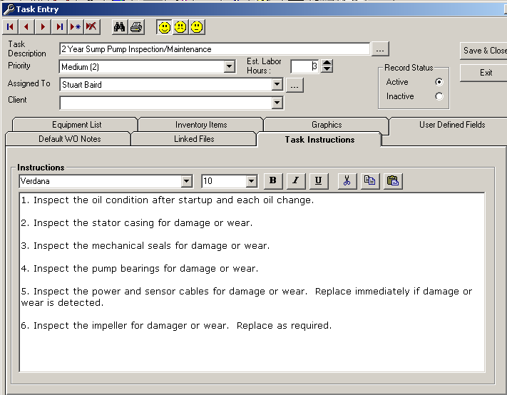
What are my best O&M and CIP investment strategies?
Description
2 Year Belt Filter Press Inspection/Maintenance
2 Year Chemical Feed System Maintenance
2 Year Sump Pump Inspection/Maintenance
2 Year UV Disinfection System Maintenance
3 Year Aeration Blower Maintenance
5 Year Chemical Feed System Maintenance
5 Year Maintenance of Grit Classifier
5 Year Sump Pump Inspection/Maintenance
6 Month Anoxic Zone Mixer Maintenance/Inspection
6 Month Belt Filter Press Inspection/Maintenance
6 Month Gravity Belt Thickener Inspection/Maintenance
6 Month UV Disinfection System Inspection/Maintenance
Aeration Tank No. 1 Gates - 6 Month Inspection / Maintenance
Aeration Tank No. 2 Gates - 6 Month Inspection / Maintenance
Aeration Tank No. 3 Gates - 6 Month Inspection / Maintenance
Aeration Tank No. 4 Gates - 6 Month Inspection / Maintenance
Annual Clarifier Drive Maintenance
Annual Air Diffuser Inspection/Maintenance

Slide 26
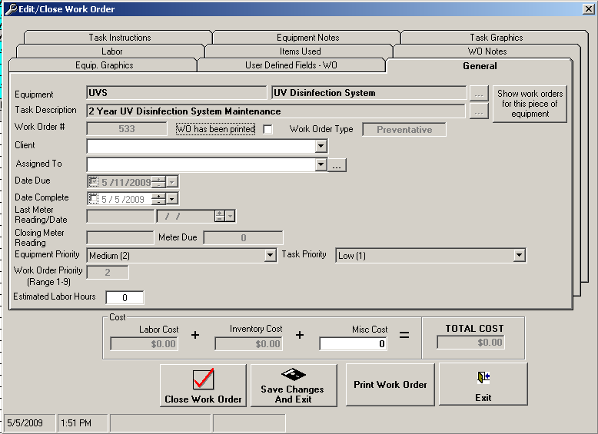
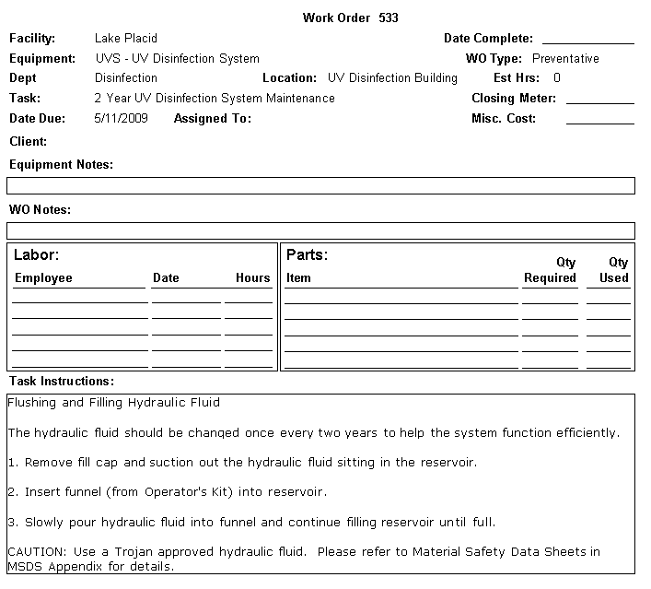
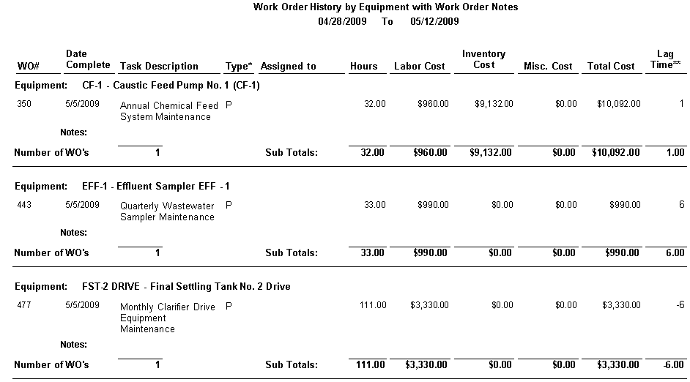
What are my best O&M and CIP investment strategies?

Slide 27
What are my best O&M and CIP investment strategies?
Risk Reduction Opportunities
Capital rehabilitation
Capital replacement
Changes to operating procedures
Changes to maintenance procedures
Demand management
Reduction of level(s) of service
Improvement in response or recovery

Slide 28
Total Projected Costs

Slide 29
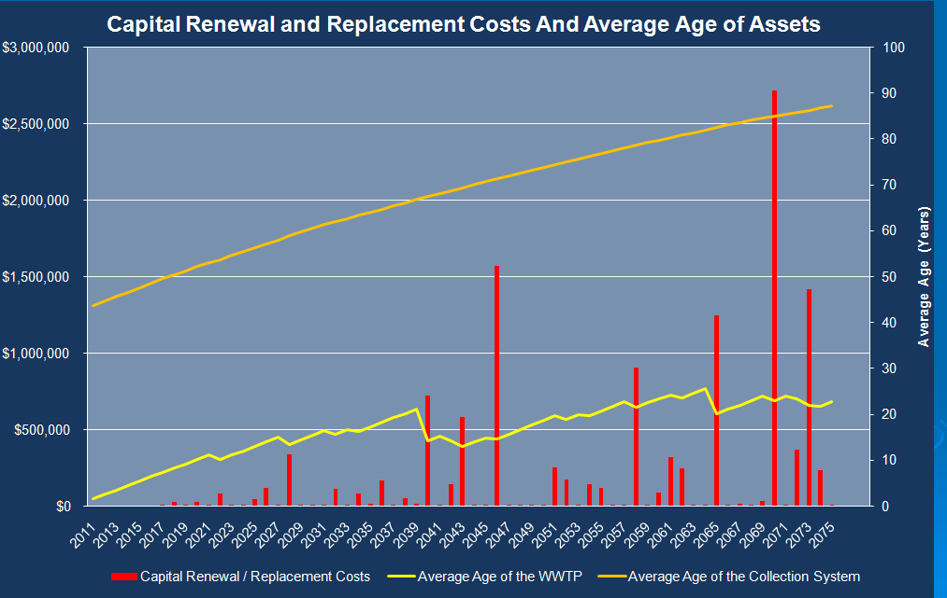
What are my best O&M and CIP investment strategies?

Slide 30
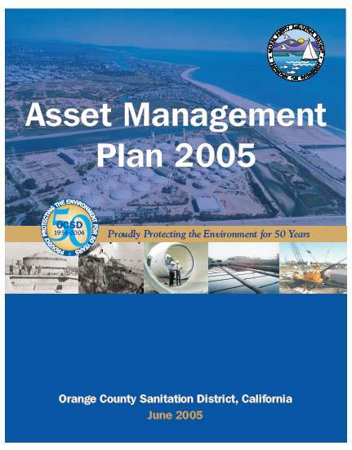
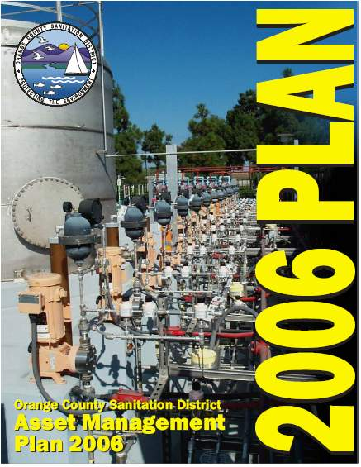
Question #5
What is my best long-term funding strategy?

Slide 31
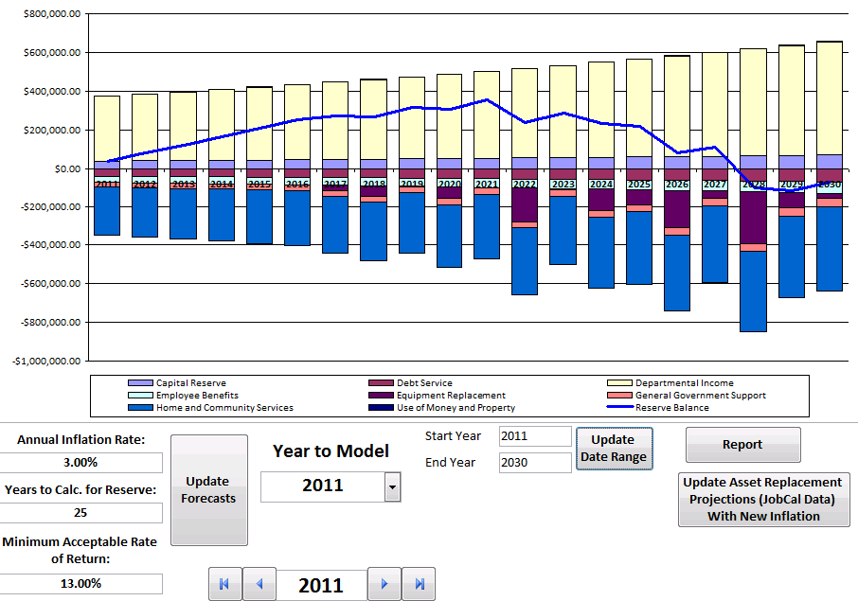
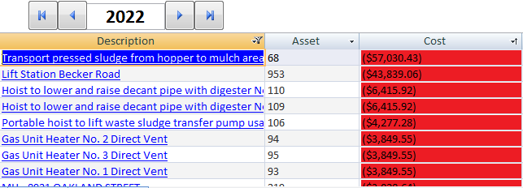
What is my best long-term funding strategy?

Slide 32
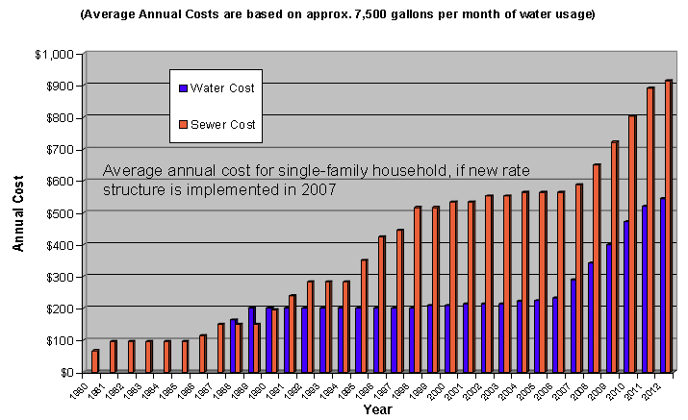
Is the rate structure sustainable?
Rates finance essential water and sewer services and ensure clean, safe drinking water.
Assess the costs of providing water and sewage services, and to recover the amount of money needed to operate and maintain them.

Slide 33
Projected Rates Over Time by Scenario
1600
1400
1200
1000
Rates ($Annual)
800
600
400
200
0
01/02
02/03
03/04
04/05
05/06
06/07
07/08
08/09
09/10
10/11
Year

Slide 34
An Asset Management Program Is
All About Knowledge Management
Wisdom
Knowledge
Information
Data

Slide 35
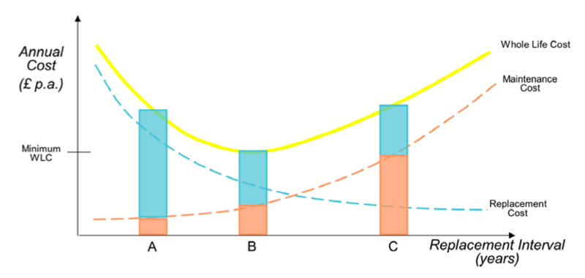
Questions?
Timothy Taber, P.E., BCEE
ttaber@bartonandloguidice.com

